Slide 1
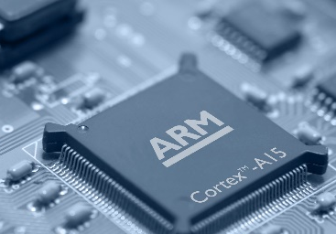
BLM206 Microprocessor Systems - Mikroişlemci Sistemleri 2.Hafta Microprocessor Overview
Bilgisayar - Biyomedikal Mühendisliği Bölümü
Öğr. Gör. Musa AYDIN
2017 – 2018 (Bahar)

Slide 2


Slide 3
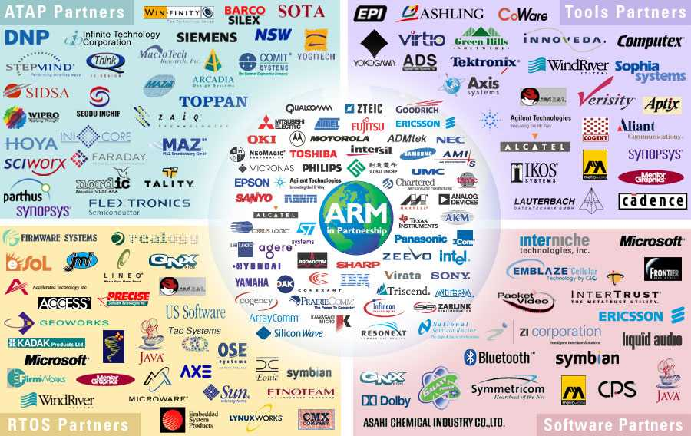
ARM Partnership Model
Notes:
ARM’s business model centres around the principle of partnership. At the centre of this are ARM’s semiconductor partners who design, manufacture and market ARM-compliant products.
Having so many partner companies producing silicon executing the same instruction set is a very important part of ARM’s strength in the market place.
However each of our semiconductor partners bring their own unique strengths to the partnership - each having their own technologies, applications knowledge, product focus, culture, geography, and key customers.
In addition to our partnering with semiconductor companies, we also partner with a large number of other third parties to ensure that operating systems, EDA and software development tools, application software and design services are available for doing ARM based designs.
“ATAP” stands for ARM Technology Access Program. Creates a network of independent design service companies and equips them to deliver ARM-powered designs. Members get access to ARM technology, expertise and support. Members sometimes referred to as “Approved Design Centers”.

Slide 4
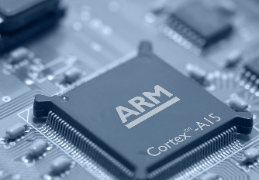
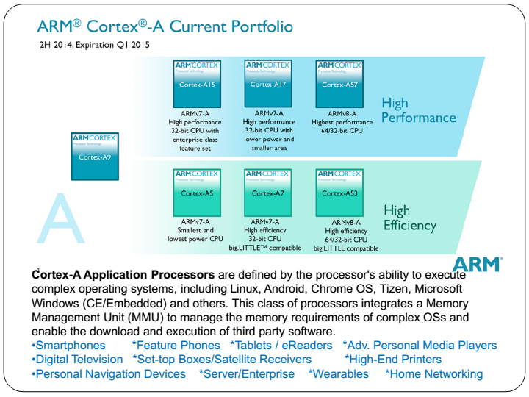

Slide 5
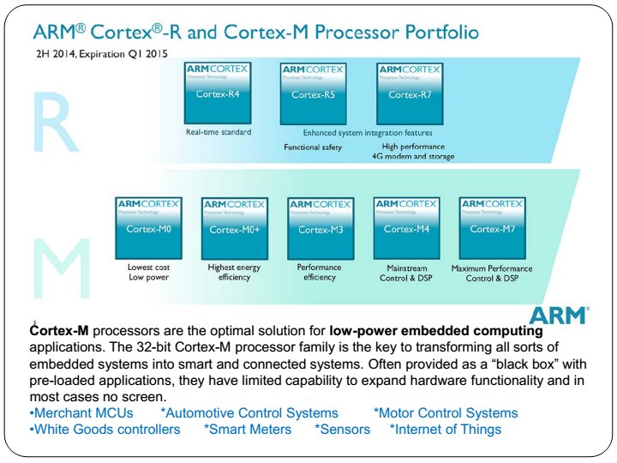

Slide 6
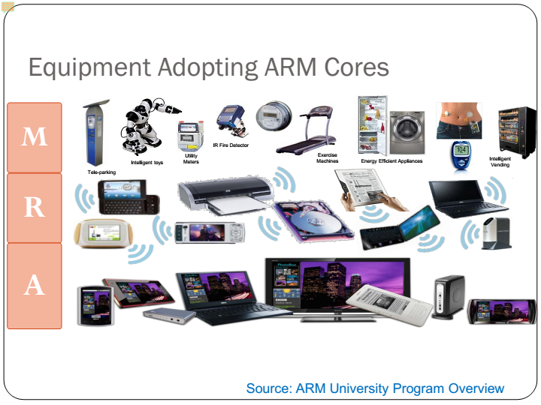

Slide 7
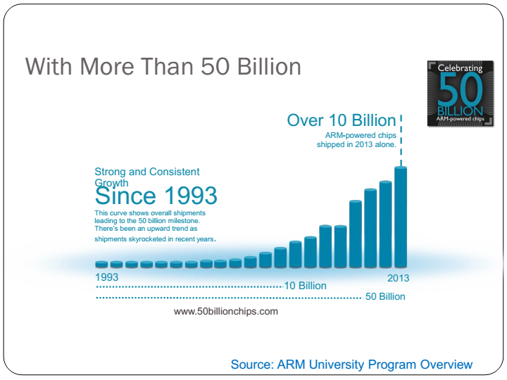

Slide 8
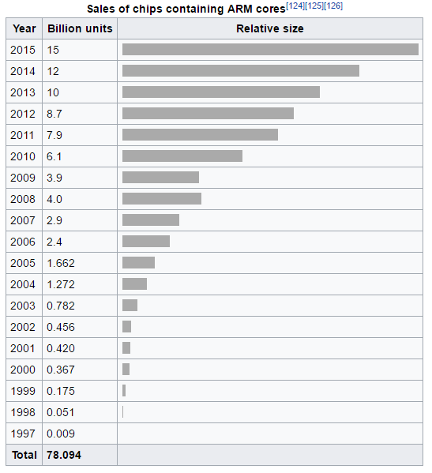

Slide 9
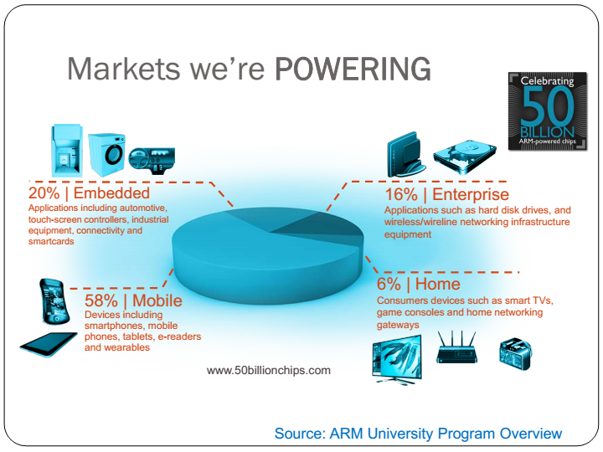

Slide 10
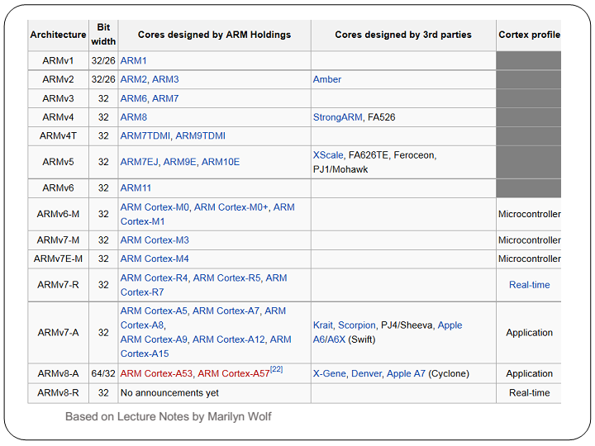

Slide 11
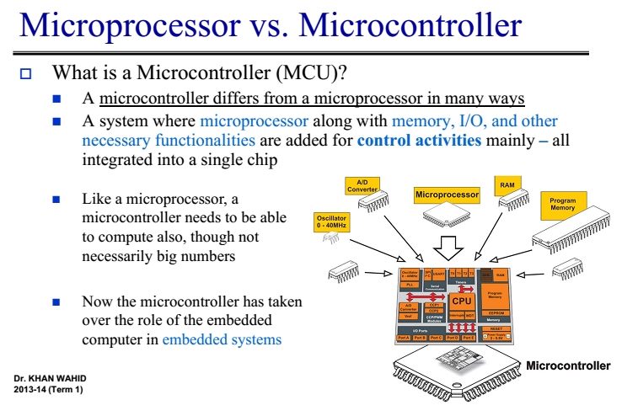

Slide 12
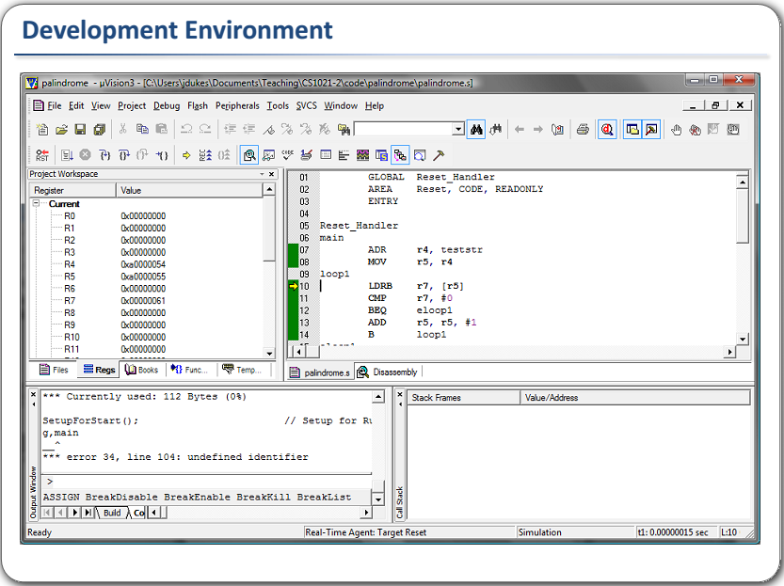

Slide 13
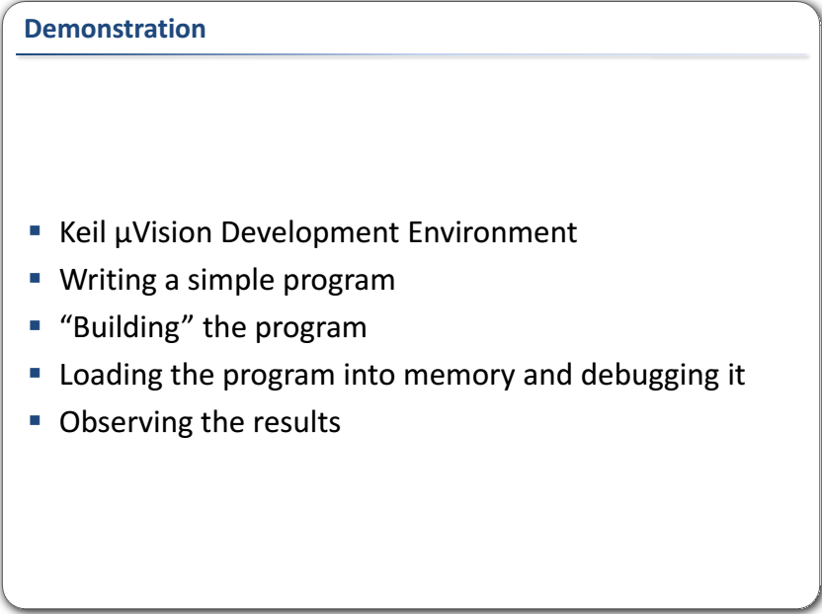

Slide 14
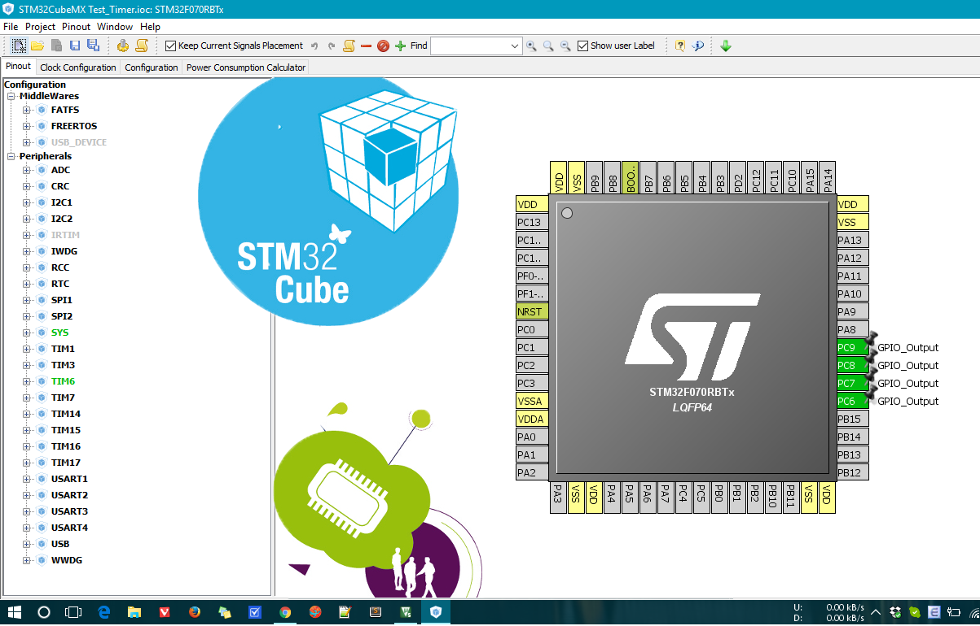
STM32Cubemx

Slide 15
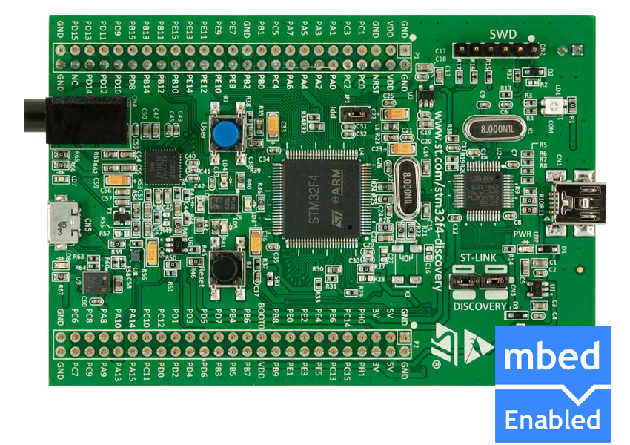
stm32f4 discovery board

Slide 16
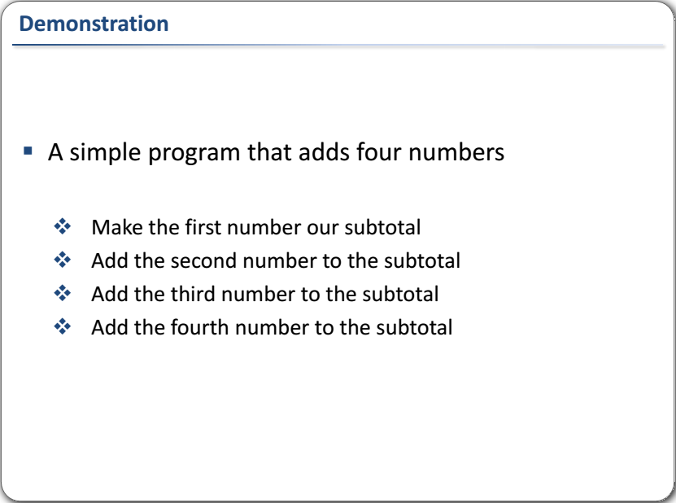

Slide 17
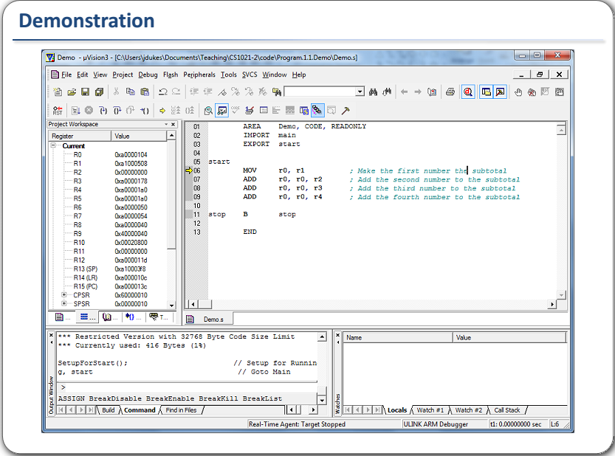

Slide 18
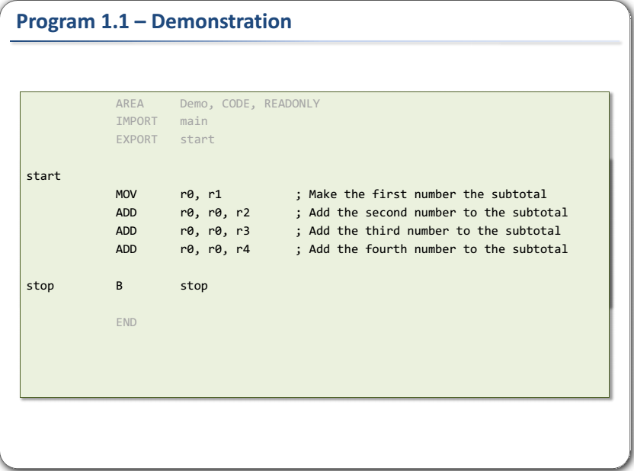

Slide 19
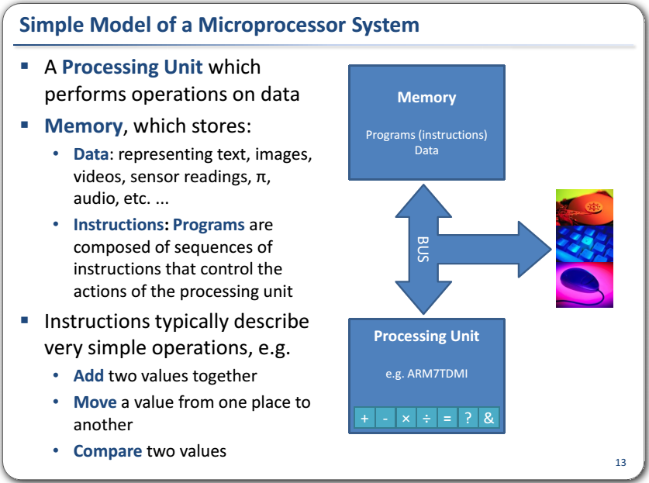

Slide 20
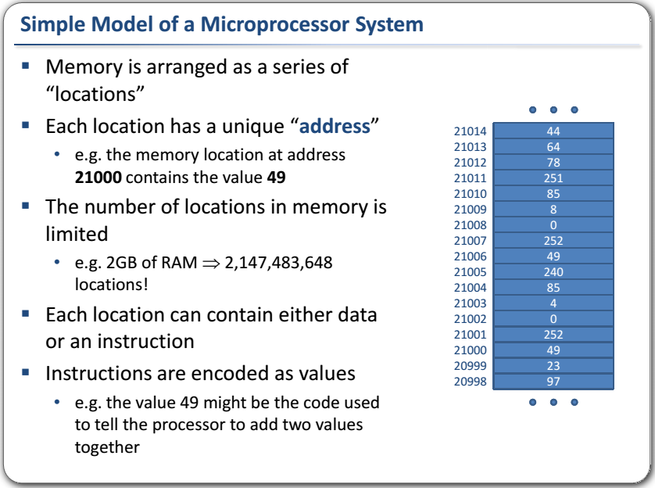

Slide 21
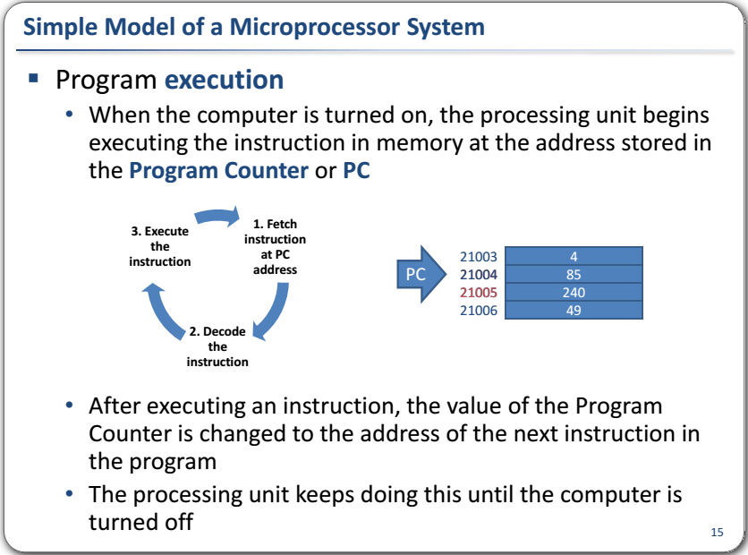

Slide 22
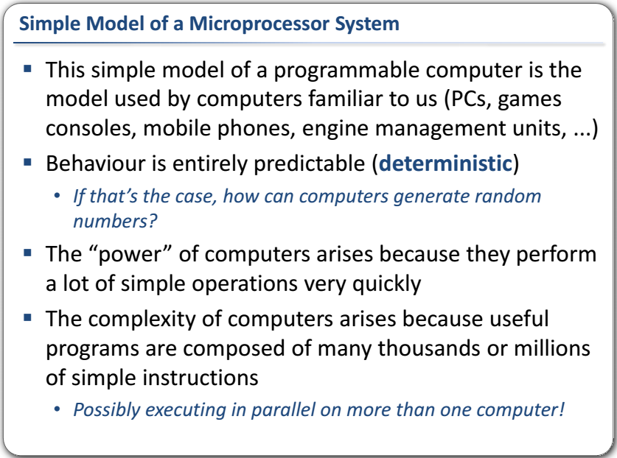

Slide 23
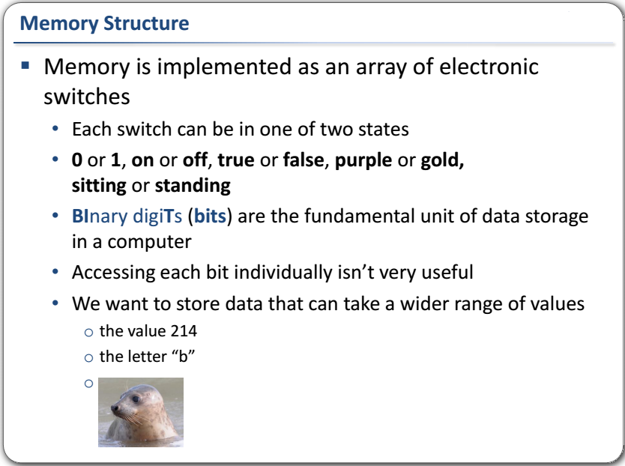

Slide 24
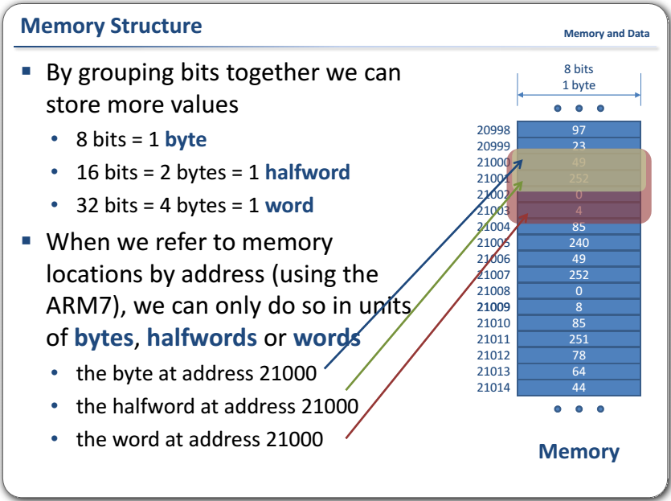

Slide 25
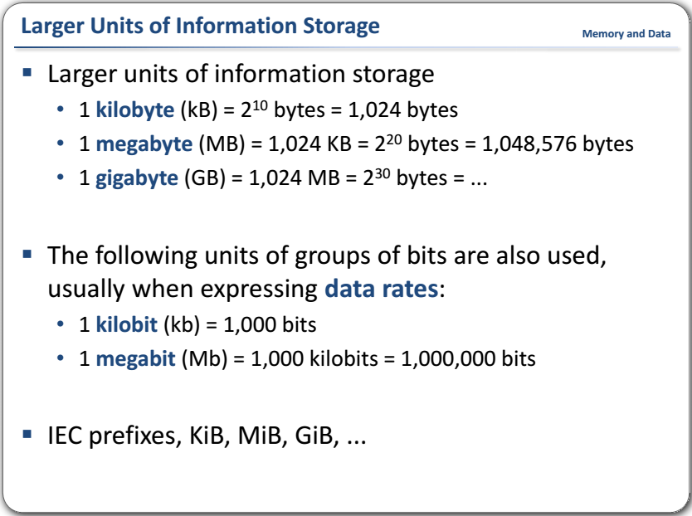

Slide 26
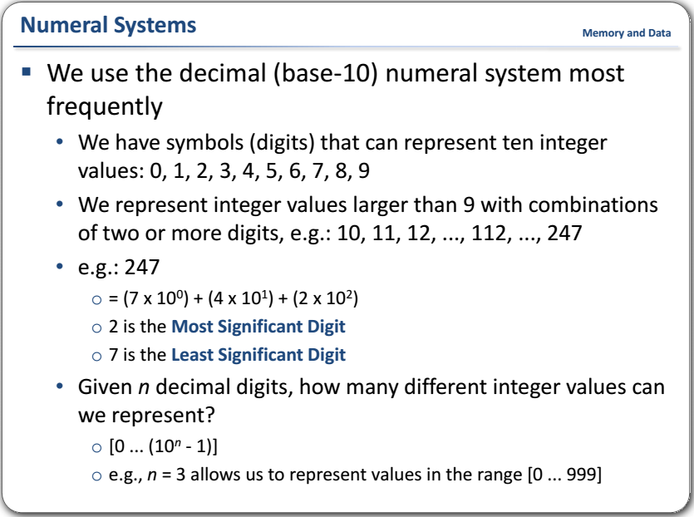

Slide 27
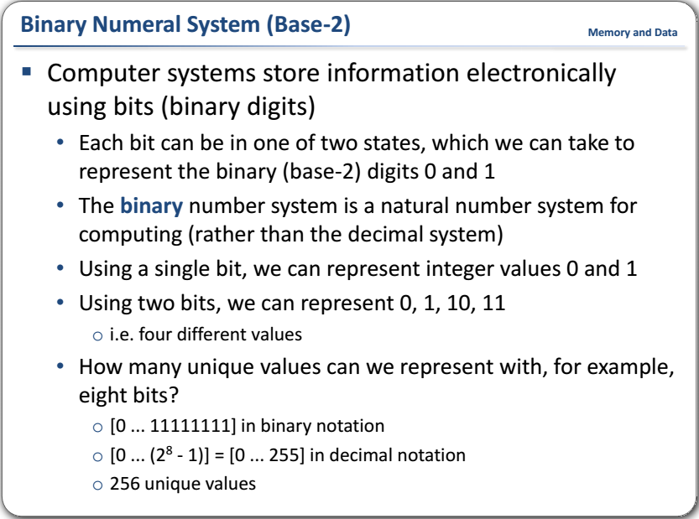

Slide 28
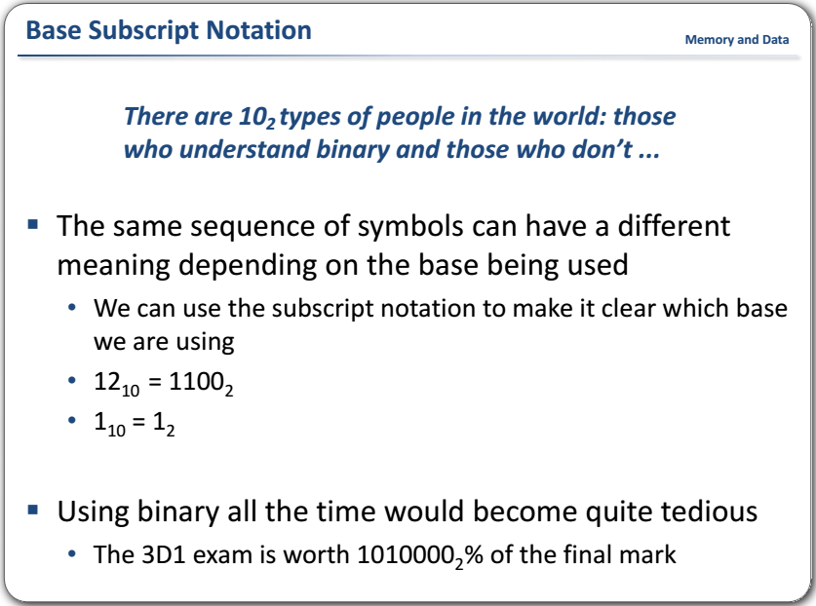

Slide 29
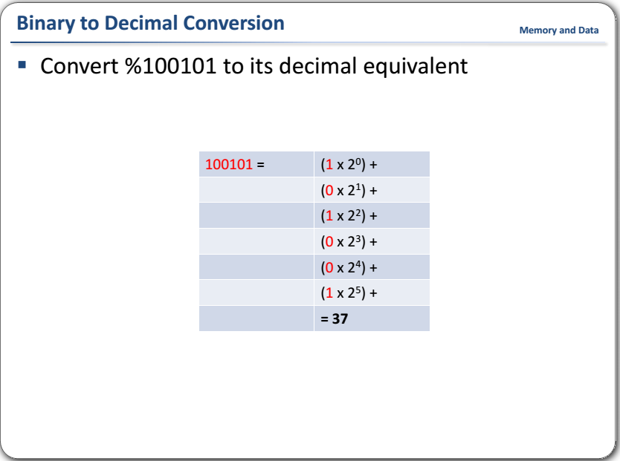

Slide 30
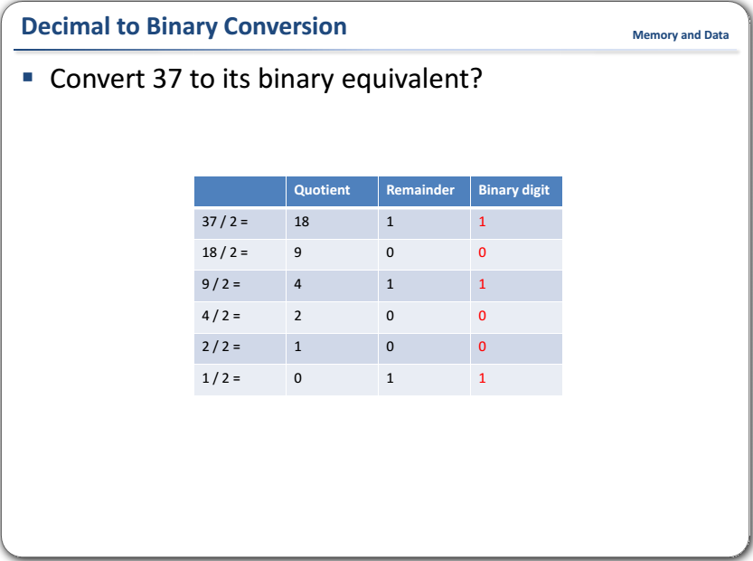

Slide 31
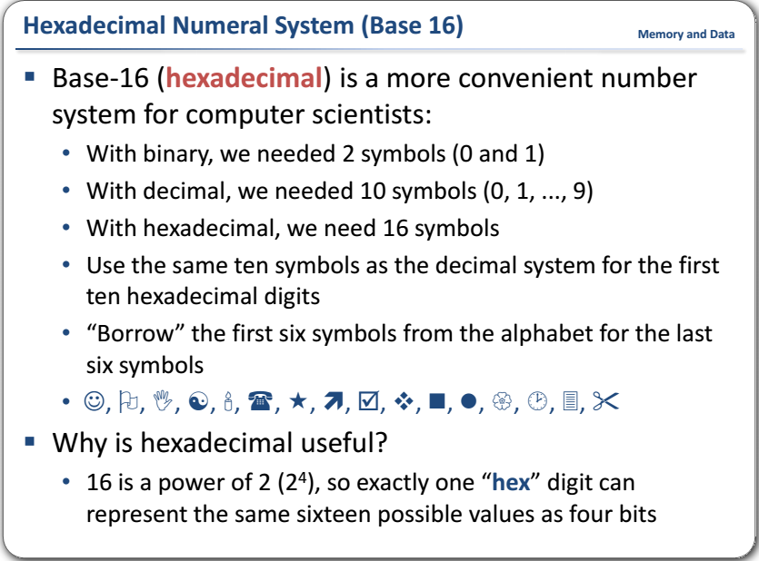

Slide 32
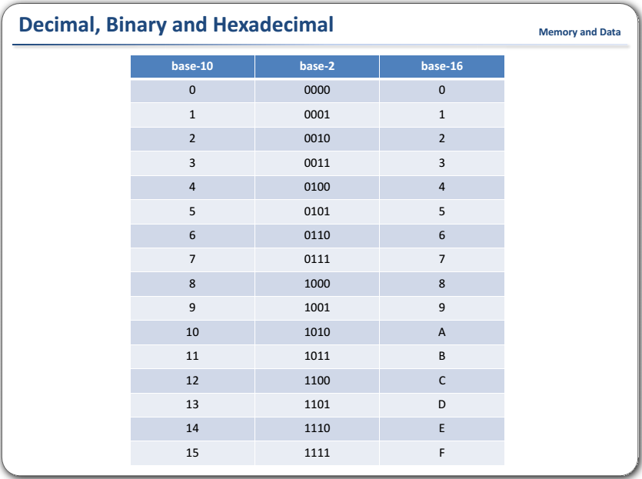

Slide 33
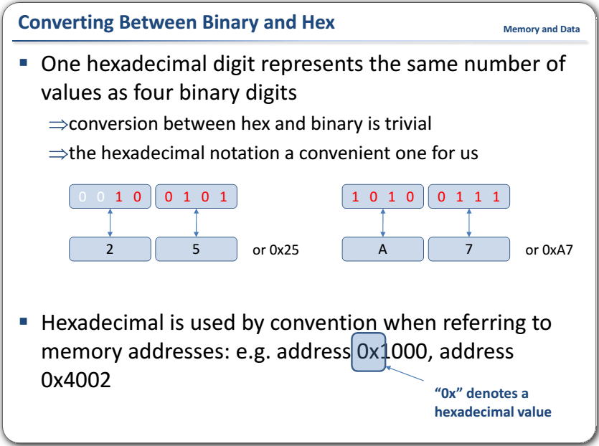

Slide 34
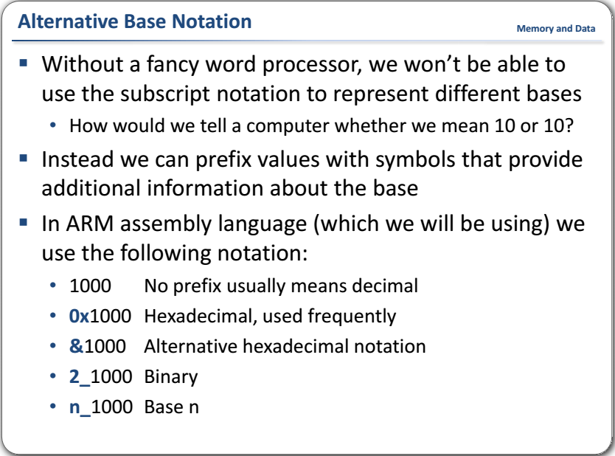

Slide 35
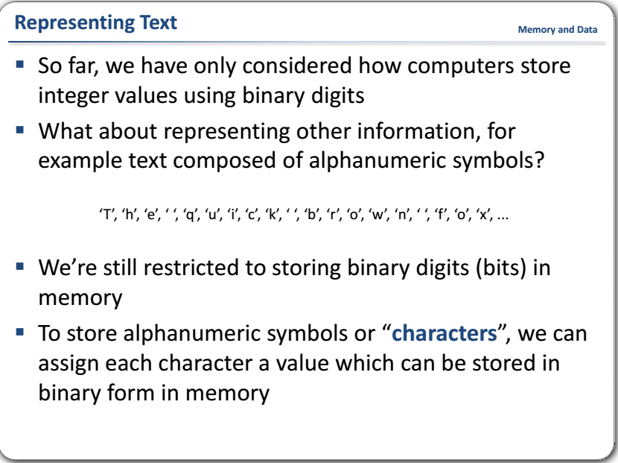

Slide 36
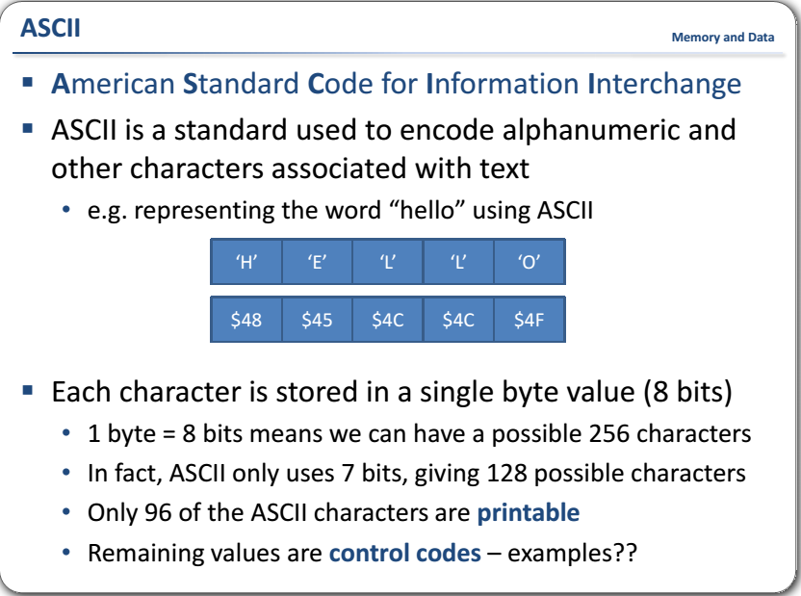

Slide 37
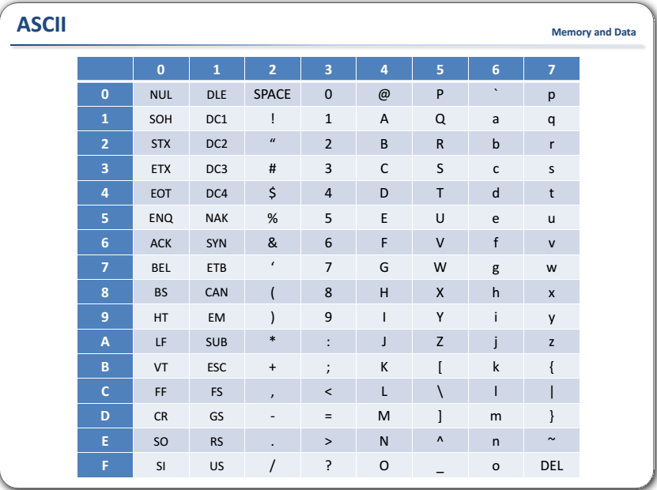

Slide 38
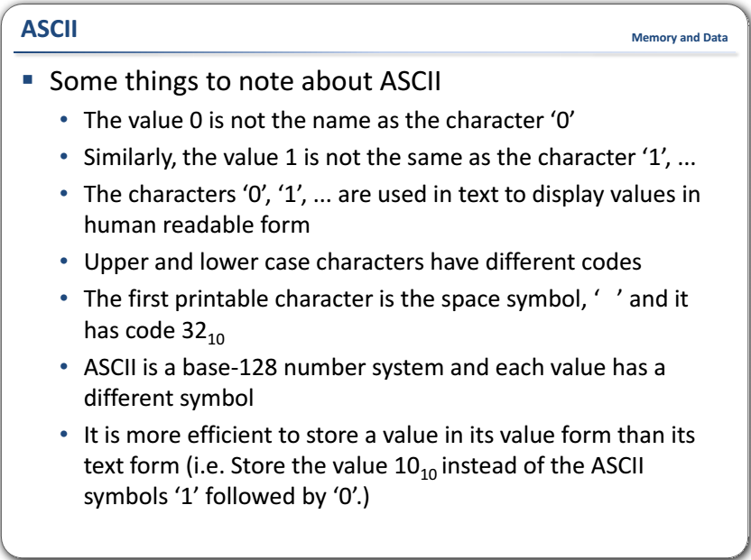

Slide 39
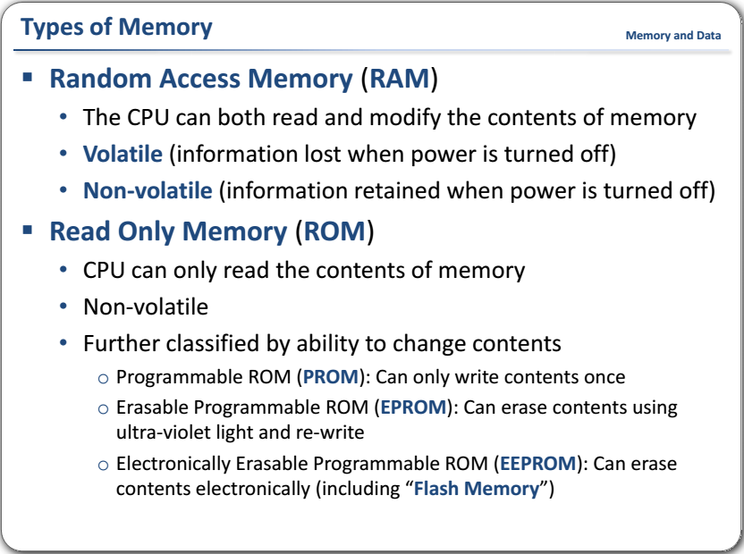

Slide 40
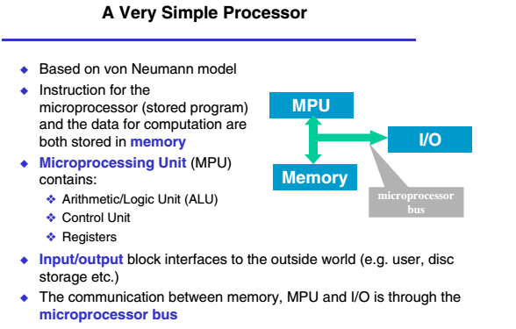
Exaple :

Slide 41
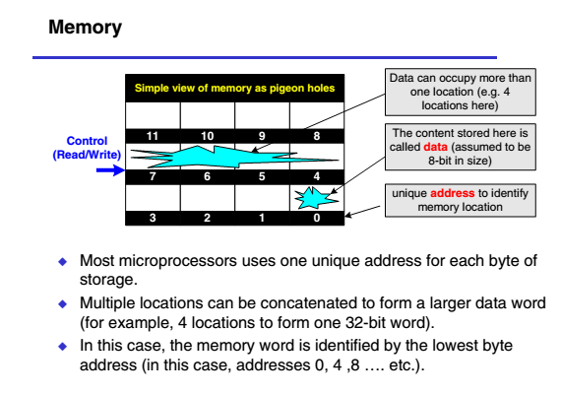

Slide 42
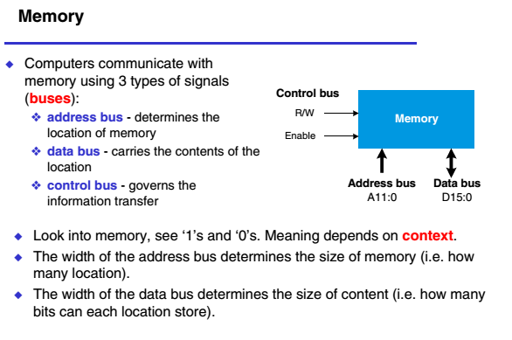

Slide 43
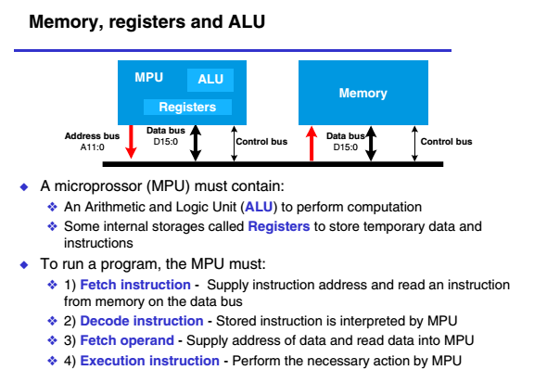

Slide 44
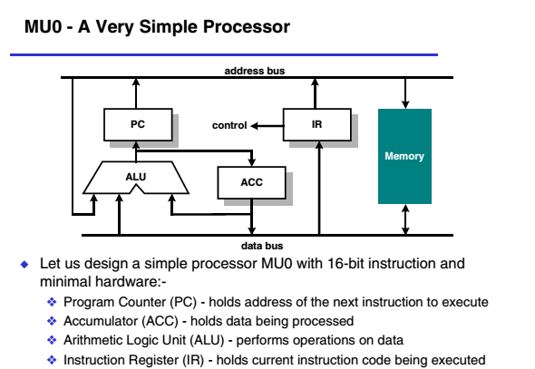

Slide 45
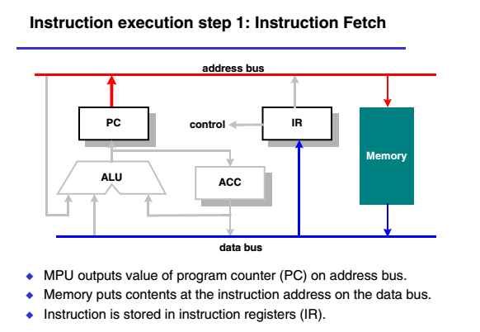

Slide 46
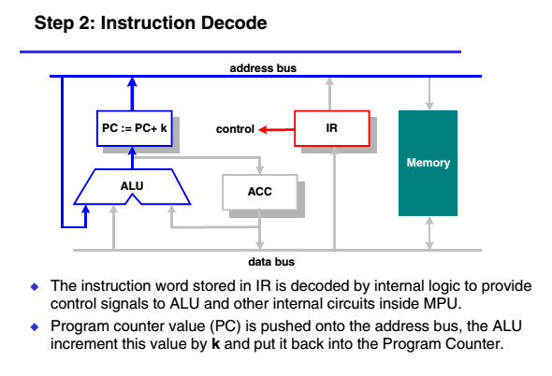

Slide 47
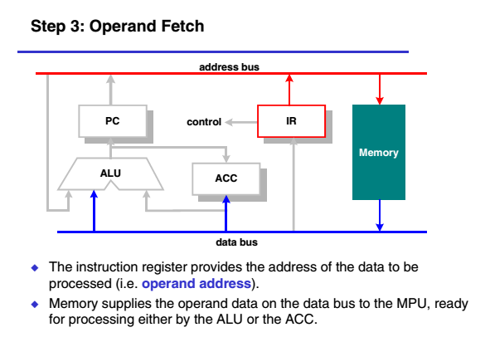

Slide 48
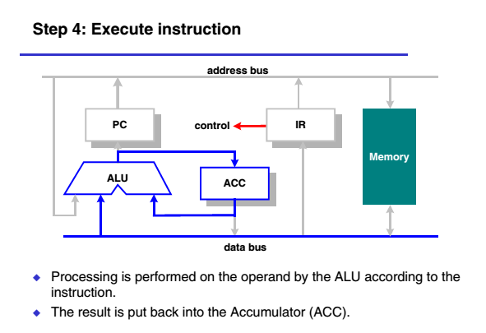

Slide 49
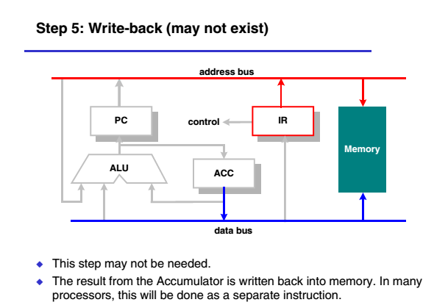

Slide 50
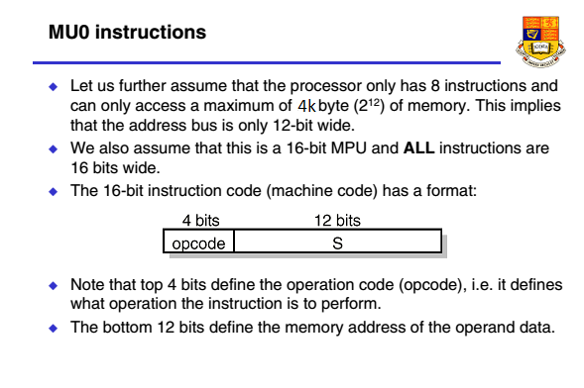

Slide 51


Slide 52


Slide 53

PC = 0
ACC = ABCD

Slide 54

PC = 1
ACC = ABCD + 4321

Slide 55

PC = 2
ACC = EEEE

Slide 56

PC = 3

Slide 57


Slide 58


Slide 59


Slide 60


Slide 61


Slide 62


Slide 63


Slide 64


Slide 65


Slide 66


Slide 67

Questions

